Slide 1
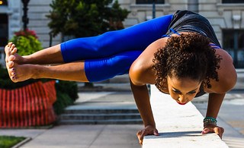
Yoga

Slide 2
There are a variety of yoga styles — vinyasa, restorative, hatha, and hot, just to name a few. Each requires a different amount of physical exertion. There’s a big difference between a restorative yoga class with very little movement and a fast-paced vinyasa class where you’re quickly moving from one challenging.
Yoga

Slide 3
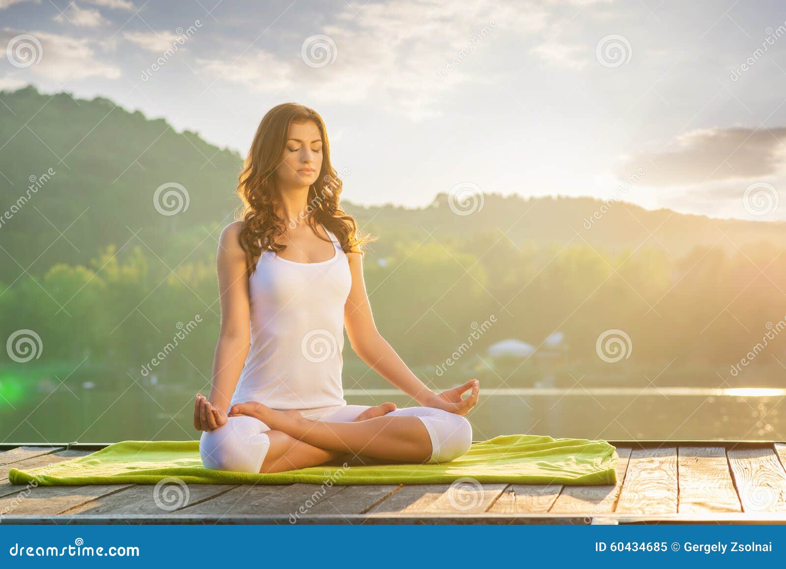
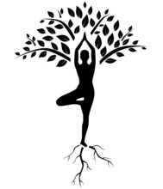
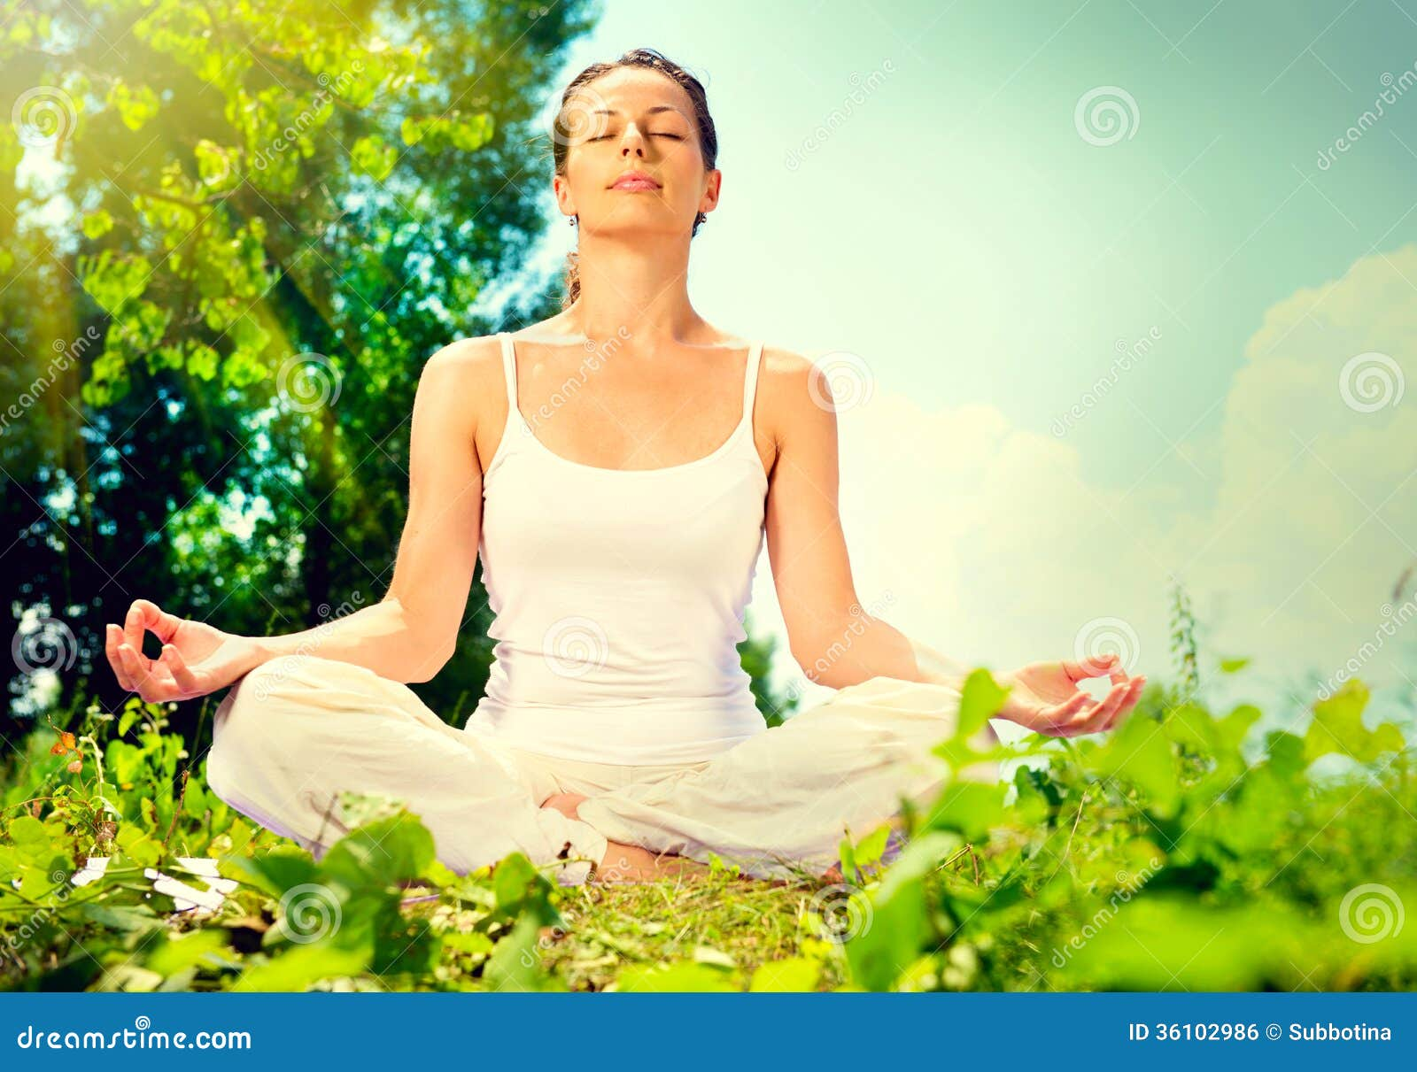

Slide 4
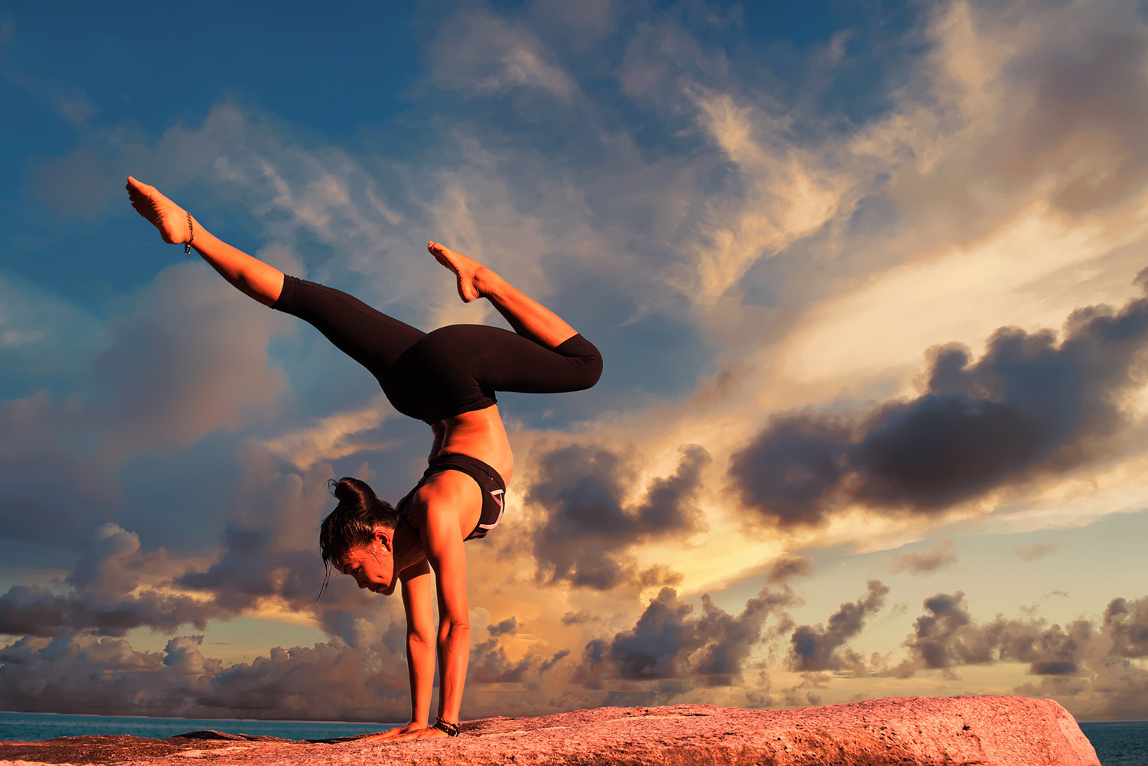
Yoga
Yoga improves strength, balance and flexibility.
Slow movements and deep breathing increase blood flow and warm up muscles, while holding a pose can build strength. Balance on one foot, while holding the other foot to your calf or above the knee (but never on the knee) at a right angle.

Slide 5
BENEFITS FOR YOGA
Yoga helps with back pain relief. ...
Yoga can ease arthritis symptoms. ...
Yoga benefits heart health. ...
Yoga relaxes you, to help you sleep better. ...
Yoga can mean more energy and brighter moods. ...
Yoga improves strength, balance and flexibility. ...
Yoga helps you manage stress

Slide 6
TYPES OF YOGA
Hatha Yoga. ...
Ashtanga Yoga. ...
Power Yoga. ...
Restorative Yoga. ...
Prenatal Yoga. ...
Aerial Yoga.
Vinyasa Yoga. ...
Kundalini Yoga. Yogi Bhajan, teacher, and spiritual leader, brought this style of yoga to the West in the late 1960s. ...

Slide 7
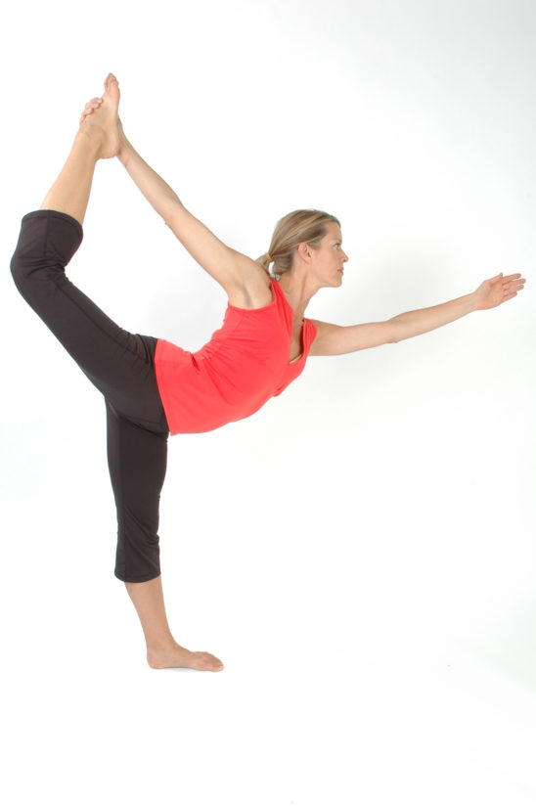
HATHA YOGA
What is the Hatha method of yoga?
Hatha yoga places special emphasis on controlled breathing and posture. Building core strength, which is key to good posture, is another important aspect of this type of yoga. Hatha has hundreds of poses, including well-known ones such as Downward-Facing Dog and Standing Forward Bend.

Slide 8
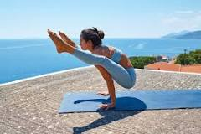
ASHTANGA YOGA
In Ashtanga Yoga every movement has a prescribed breath -inhale or exhale -and the practitioner learns the vinyasa together with the asanas: breath and movement become one. The more the practitioner masters the breathing/movement connection, the more the practice becomes fluid and effortless, a moving meditation

Slide 9
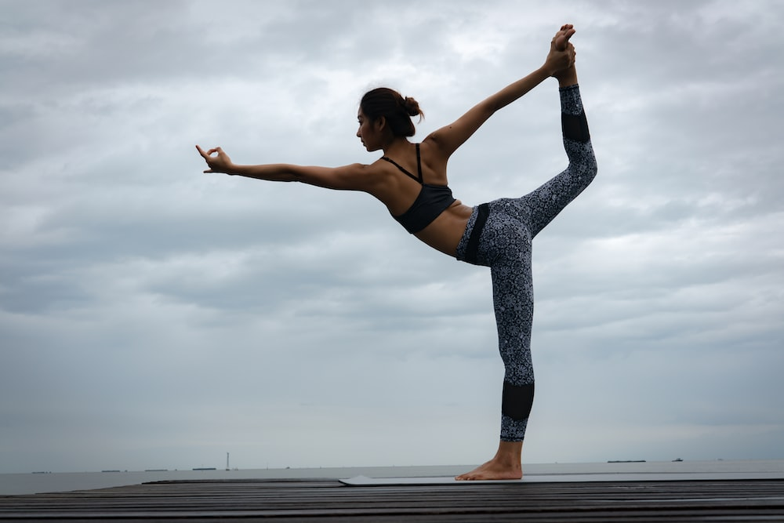
POWER YOGA
What is the power yoga?
Power yoga is typically focused on increasing heart rate and burning calories through a full-body workout and is sometimes referred to as gym yoga. A blend of Vinyasa-style poses. At least half of the asanas (postures) in a power yoga class come from Vinyasa yoga sequences, where you link breath to movement

Slide 10
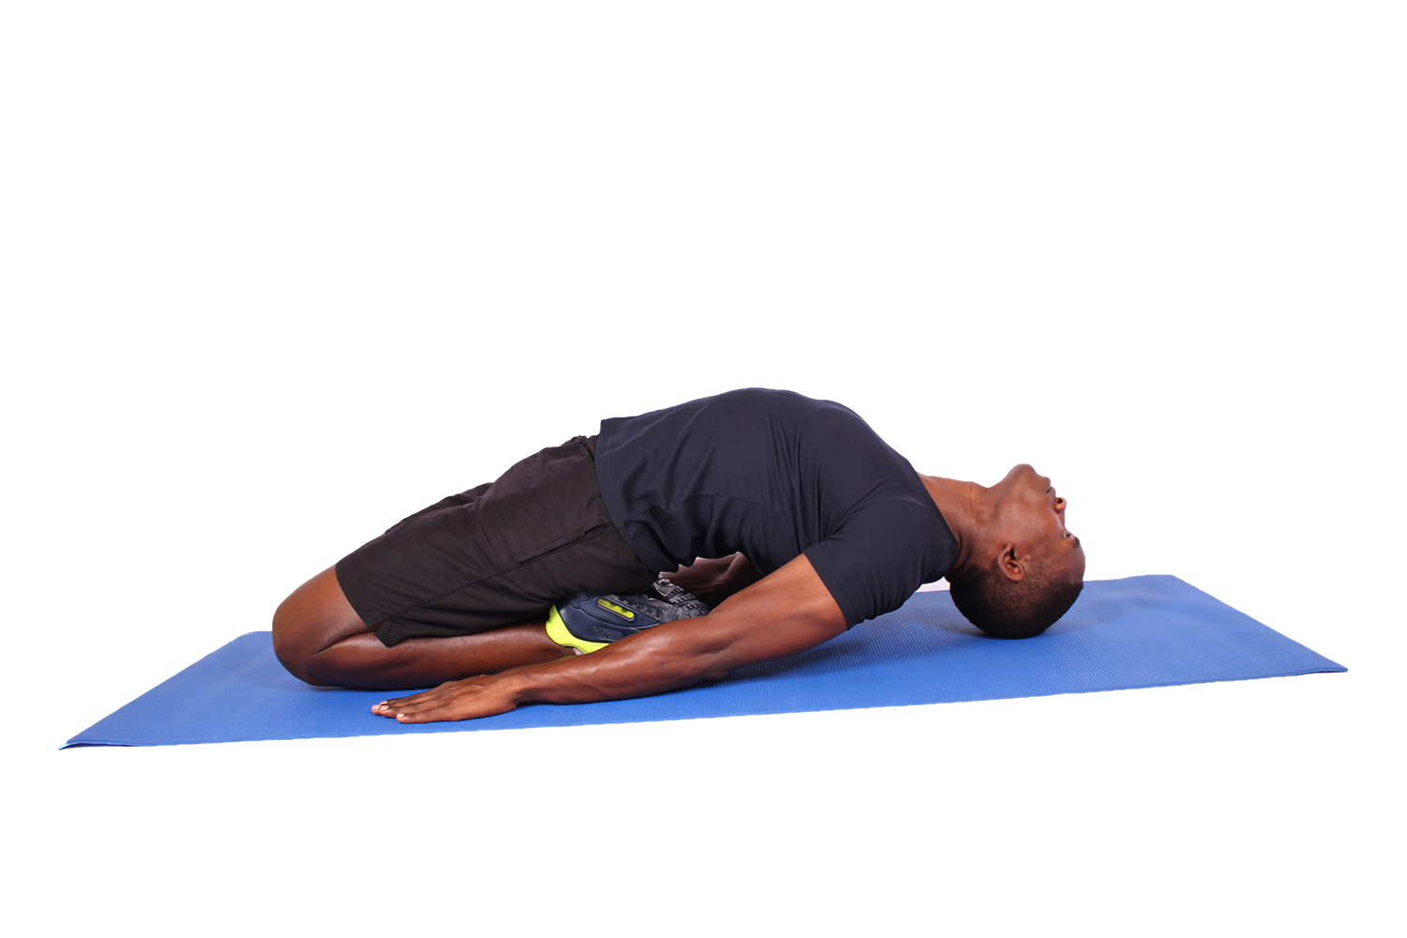
RESTORATIVE YOGA
Restorative yoga is a style of yoga that encourages physical, mental, and emotional relaxation. Appropriate for all levels, restorative yoga is practiced at a slow pace, focusing on long holds, stillness, and deep breathing.

Slide 11
PRENATAL YOGA
Prenatal yoga is a type of yoga designed for pregnant women. Yoga is intended to create a balance between emotional, mental, physical, and spiritual dimensions. Prenatal yoga is about helping you prepare for childbirth by relaxing the body and focusing on safe techniques and poses in all stages of pregnancy.

Slide 12
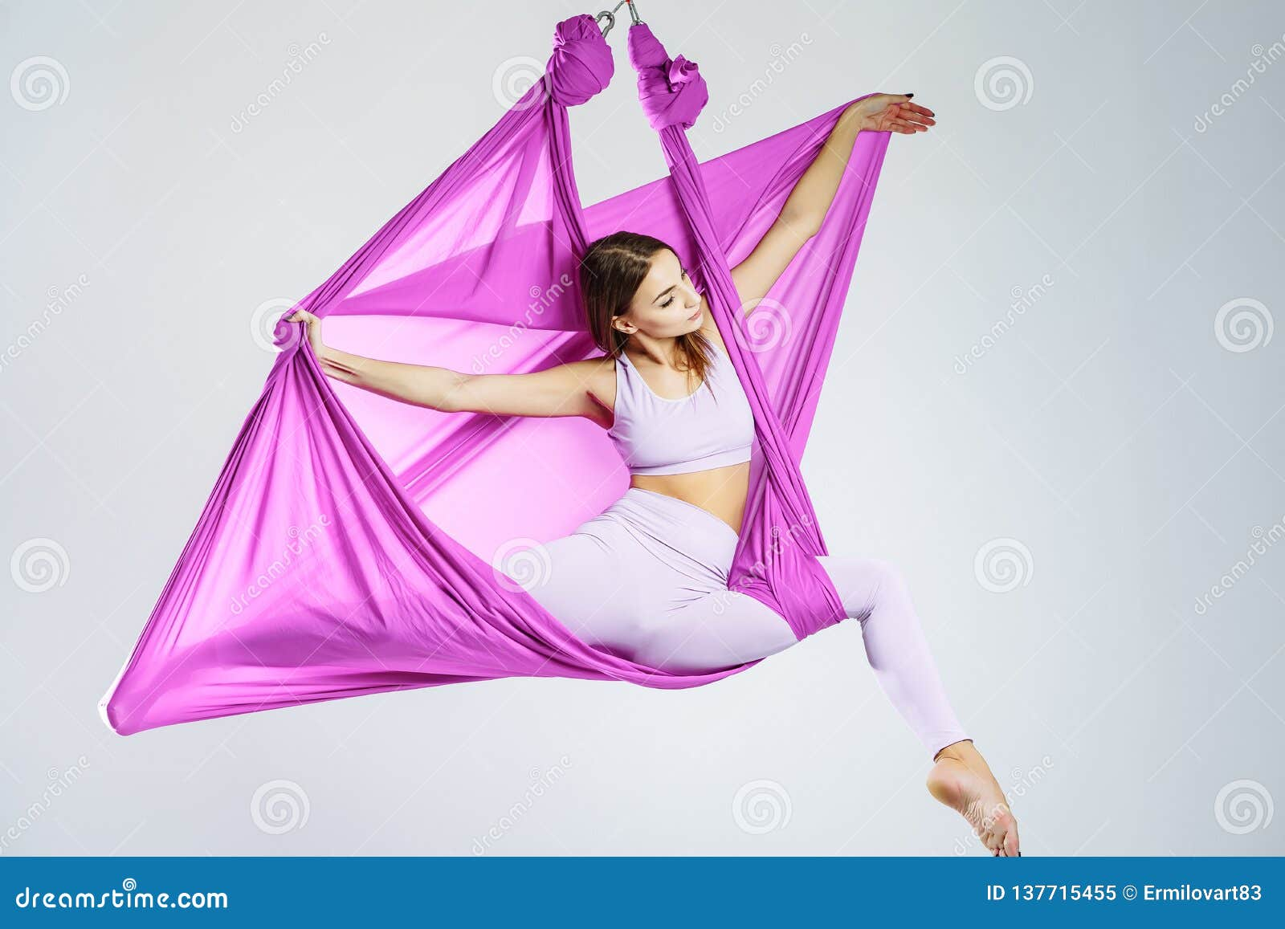
AERIAL YOGA
Aerial yoga helps rotate and move 'stagnant' blood that is staggered in the body. By encouraging healthy blood circulation, aerial yoga can help fight heart disease and additionally, lower the risk of cardiovascular disease.

Slide 13
THANK YOU
MADE BY ANJALI PATHAK

